Slide 1
FlexTensor:An Automatic Schedule Exploration and Optimization Framework for Tensor Computationon Heterogeneous System
ASPLOS 2020

Slide 2
Background & Problem
Tensor computations : computing-intensive kernels(deeply-nested loops).eg.GEMM,Conv2d,Conv3d.
Heterogeneous System.（CPU/GPU/FPGAs）
Problems:
Design a high-performance library for various tensor algorithms on heterogeneous systems.
Hand optimized low-level kernels.eg: cuDNN for GPUs, MKL for Intel CPU, FBLAS for FPGAs.
long time cost, lots of human efforts, too slow for quick evaluation of algorithm.
Leverage high-level abstraction to describe tensor algorithms and employing tensor compilers to generate the low-level implementations automatically.
Compute Description: high-level, algorithm, mathematic expressions.
Scheduling: primitives, hardware-specific, parameters for optimization.eg.split, reorder, fuse,compute_at, cache_read, tile, compute_inline.
Many primitives to choose, complex combinations and huge parameter space.

Slide 3
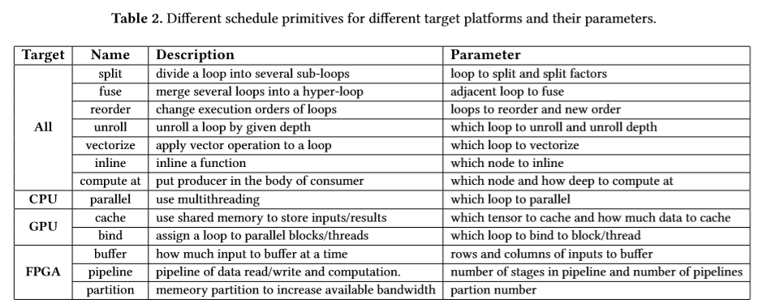
Background & Problem

Slide 4
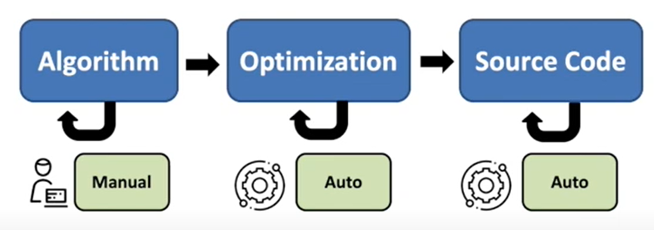
Motivations
An ideal framework
auto-optimization：自动探索调度空间。
High-performance：在不同的异构硬件上有好的表现。
Portable：支持多种硬件。
No low-level programming：给用户接口，仅在高层次上进行探索，不需要动底层的代码。
Short development time：探索优化方式的时间短。
FlexTensor：a schedule exploration and optimization framework for tensor computations on heterogeneous systems。
Focus on algorithm
Hide hardware details from users
Only expertise in algorithm

Slide 5
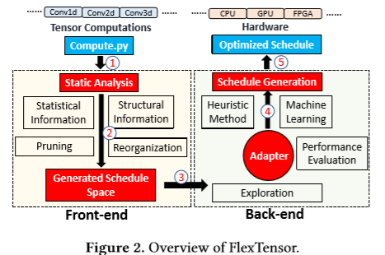
FlexTensor
How to generate schedule space
Exploration for good schedule

Slide 6
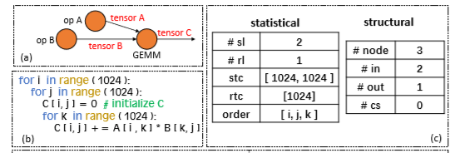
Static Analysis
Statistical information （单个计算算子）
Loop trip counts
number of loops
Loop order
Structural information（算子构成的子图）
Computation graph
Producer consumer relationship(前驱/后继)

Slide 7
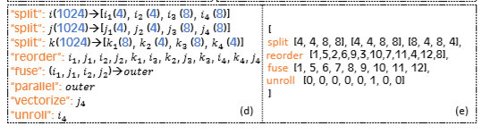

Schedule Space Generation
The schedule space is generated by enumerating different combinations of schedule primitives and corresponding parameters using statistical and structural information.
split, reorder, fuse,compute_at, cache_read, tile, compute_inline.
Principles:
Limit the depth of primitives combination. e.g.at most use split and fuse for four times.
Prune the parameter space.eg. Limit the split factors to divisible split choices for each loop.
Pre-determine certain decisions for different hardware.
CPU, parallelize the outer-most loop (after fusion) and vectorize the inner-most loop;
GPU, bind outer loops to thread blocks and inner loops to threads;
on FPGA, use three-stage pipeline design,

Slide 8
Back-end Exploration and Optimization
Composition
Searching space 𝐺
Each point in 𝐺 is represented as a vector, has been evaluted.
Adjacent points : different from 𝑝 at only one position of 𝑝 . E.g, modify the split factor only or change a value from 0 to 1 to enable/disable one schedule primitive.
A performance value 𝐸 with each point.
Run the program on the target device to collect the real performance.
Use an analytic model to obtain an estimated performance.
Steps
which point in 𝐻 is selected as the starting point for the next step.—Heuristic Method(simulated annealing)
Given the starting point 𝑝,which direction 𝑑 to move along to get a new point in 𝐺.—Q learning.

Slide 9
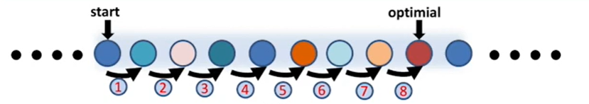
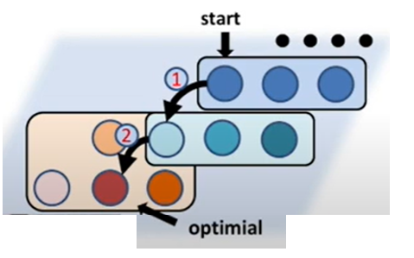
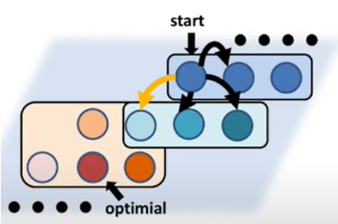
Schedule Space Rearrangement
Rearrange to high-dimensional space can potentially shorten the path from the starting point to optimal point.
which point in 𝐻 is selected as the starting point for the next step.—Heuristic Method(simulated annealing)
Given the starting point 𝑝,which direction 𝑑 to move along to get a new point in 𝐺.—Q learning.
Evaluate each point : run on target device/cost model

Slide 10
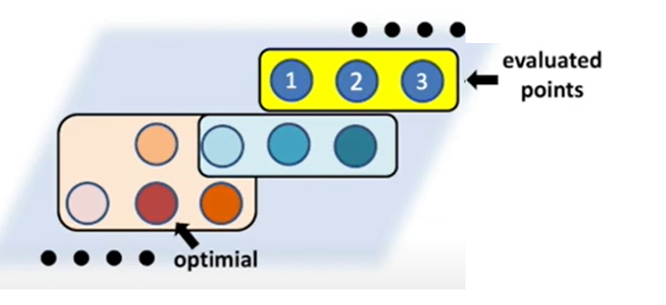
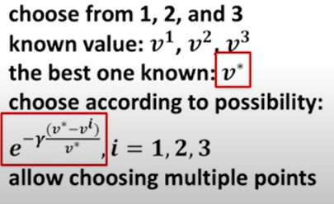

Heuristics: simulated annealing
For a point 𝑝 in 𝐻, its performance value is denoted as 𝐸𝑝.
During the exploration,FlexTensor tracks the best point(with the highest 𝐸 value) in 𝐻,and denote its performance value as 𝐸∗.
FlexTensor chooses a point 𝑝 in 𝐻 as the starting point for next step with probability where 𝛾 is a hyper parameter.
The closer 𝐸𝑝 is to 𝐸∗,the more likely 𝑝 is chosen as the starting point.

Slide 11
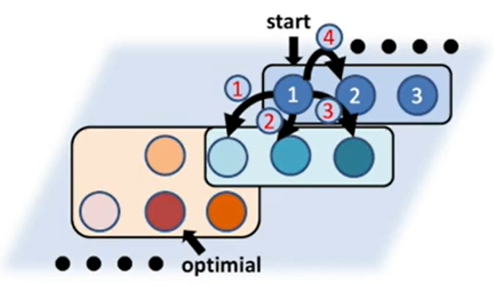
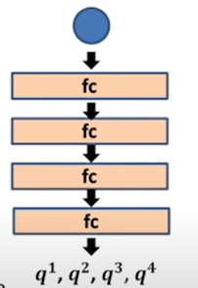
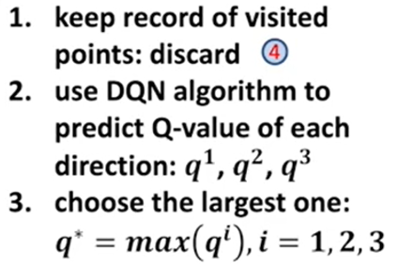



Q learning
State set: point 𝑝 , action set : directions, the reward value
Evaluate the new point 𝑒 and record the results as a tuple(𝑝, 𝑒, (𝐸𝑒−𝐸𝑝)/𝐸𝑝 ).
Calculate target value (i.e.label)using the formula:
use mean squared error: as loss value and run AdaDelta algorithm.

Slide 12
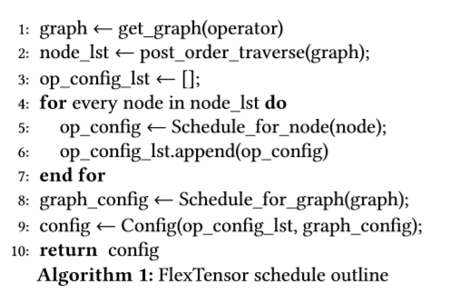
Optimized Schedule Implementation
bottom-up order: generates a schedule for each node in a mini-graph first and then generates schedules for the whole graph.
top-down order: generates a schedule for the whole graph first and then generates schedules for each node in a mini-graph .
Recurrent order:repeat bottom-up order or top-down order for several times

Slide 13
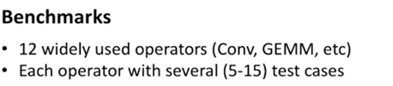

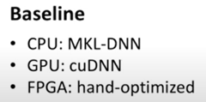
Evaluation

Slide 14
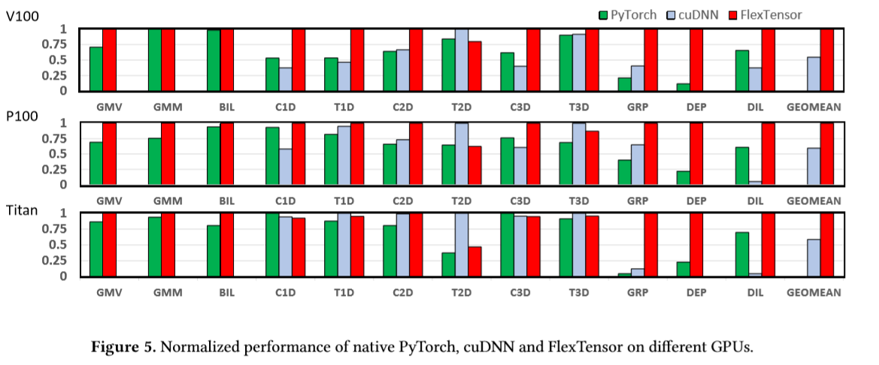
Evaluation
The average speedup of all benchmarks to cuDNN is 1.83x on V100, 1.68x on P100 and 1.71x on Titan X.

Slide 15
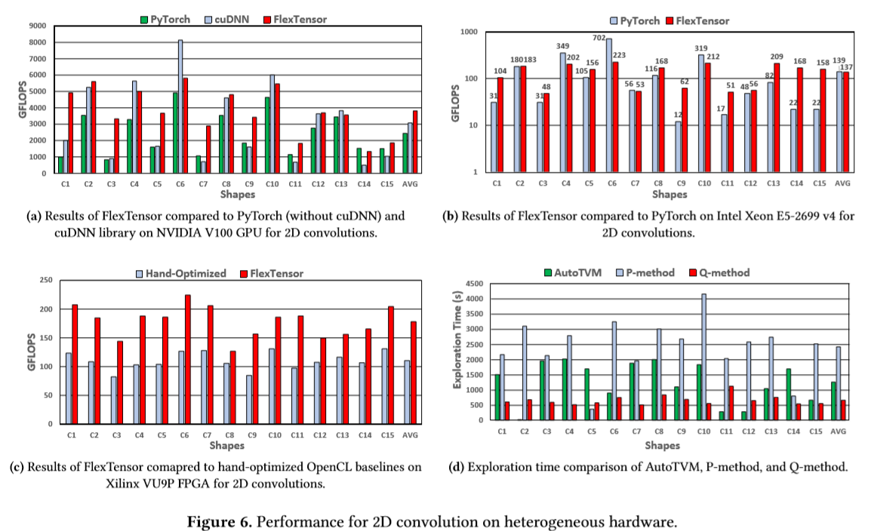
Evaluation

Slide 16
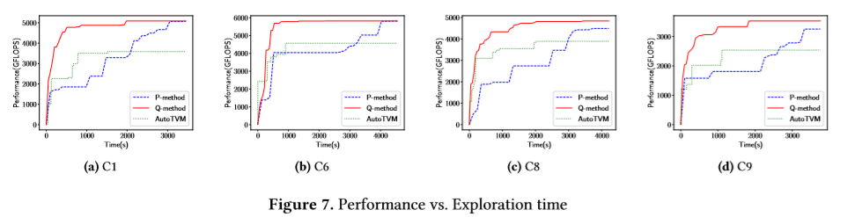
Evaluation
Q-method(red): our method
P-method(blue): our method without Q learning
Baseline(green): autotvm
Conclusion: Q-method only use 27.6% the time of autotvm.

Slide 17
Personal view
这篇文章的主要工作集中在optimization这一步，代码生成是基于TVM。
主要的创新点使用heuristics量化每个schedule节点的贡献度，通过Q learning来探索最优的解，可以保证所有的探索过程是自动化的。
Motivation | Ideal | FlexTensor
Optimization | Auto | Automatic schedule exploration
Portable | Yes | Support CPU,GPU,FPGA
Performance | High | Speedup:1.38x on GPU,1.72x on CPU,1.5x on FPGA
Programming | High level | Only compute description in Python
Development time | short | 10 min – 1 hour

Slide 18
谢 谢！

